Slide 1

NYC Trip-Duration Prediction
Time Series Project
5-12-2020

Slide 2
Contents :
01
02
03
04
05
06
Tools
Conclusion
Introduction
EDA
Model
Design

Slide 3
Introduction :
The goal of this statistical analysis is to help us understand the relationship between trip duration and other features in the dataset that affect the trip duration.
01
Business Problem:
Predect the trip duration time that depends
on specific features extracted from the dataset.

Slide 4
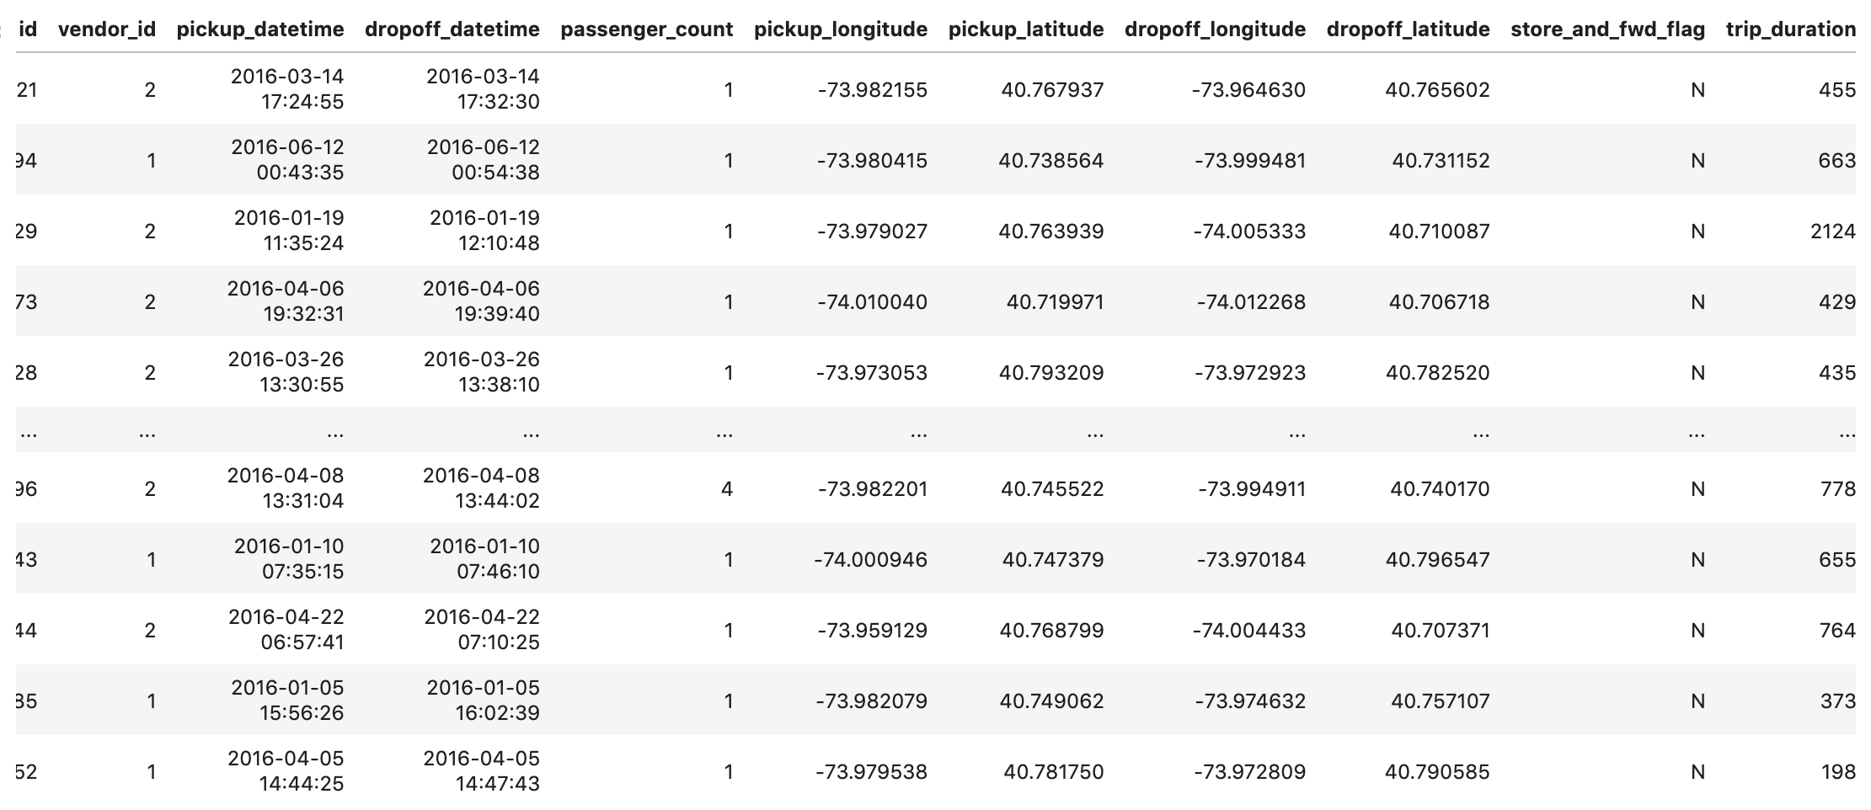
Design :
02
Dataset
Dataset source:
From Kaggle website [Kaggle]
Size of Data:
Number of rows: 1458644
Number of columns: 11
Notes:
مو حلو الخط غيريه

Slide 5
Design :
02
Challenges
1
Drop outliers
3
Convert type of columns
Drop rows that have outliers in the target variable ( Trip Duration)
Change the trip duration from sec to hours
Change pickup datetime & drop off datetime from object to DateTime
2
Add new columns
4
Find a model
Create new Day, Day of week and Hour columns from Pickup & drop off time
Find a good model that fits the client requirements
Notes:
مو حلو الخط غيريه

Slide 6
EDA :
1-Trip Duration per Hour and per Day
2-Is there a relationship between Distance and Trip Duration?
3-Distance per Hour and per Days
4-Is Vendor Id have relationships with Trip Duration?
5-What Vendor have the most Trips?
6-Which Days has the highest number of Passengers?
7-Features Correlating with Trip Duration
03
Guide questions to explore and analyze the data
Notes:
مو حلو الخط غيريه

Slide 7
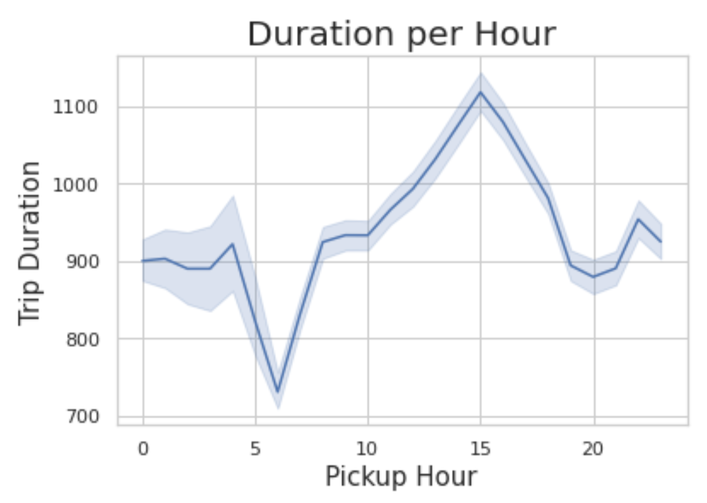
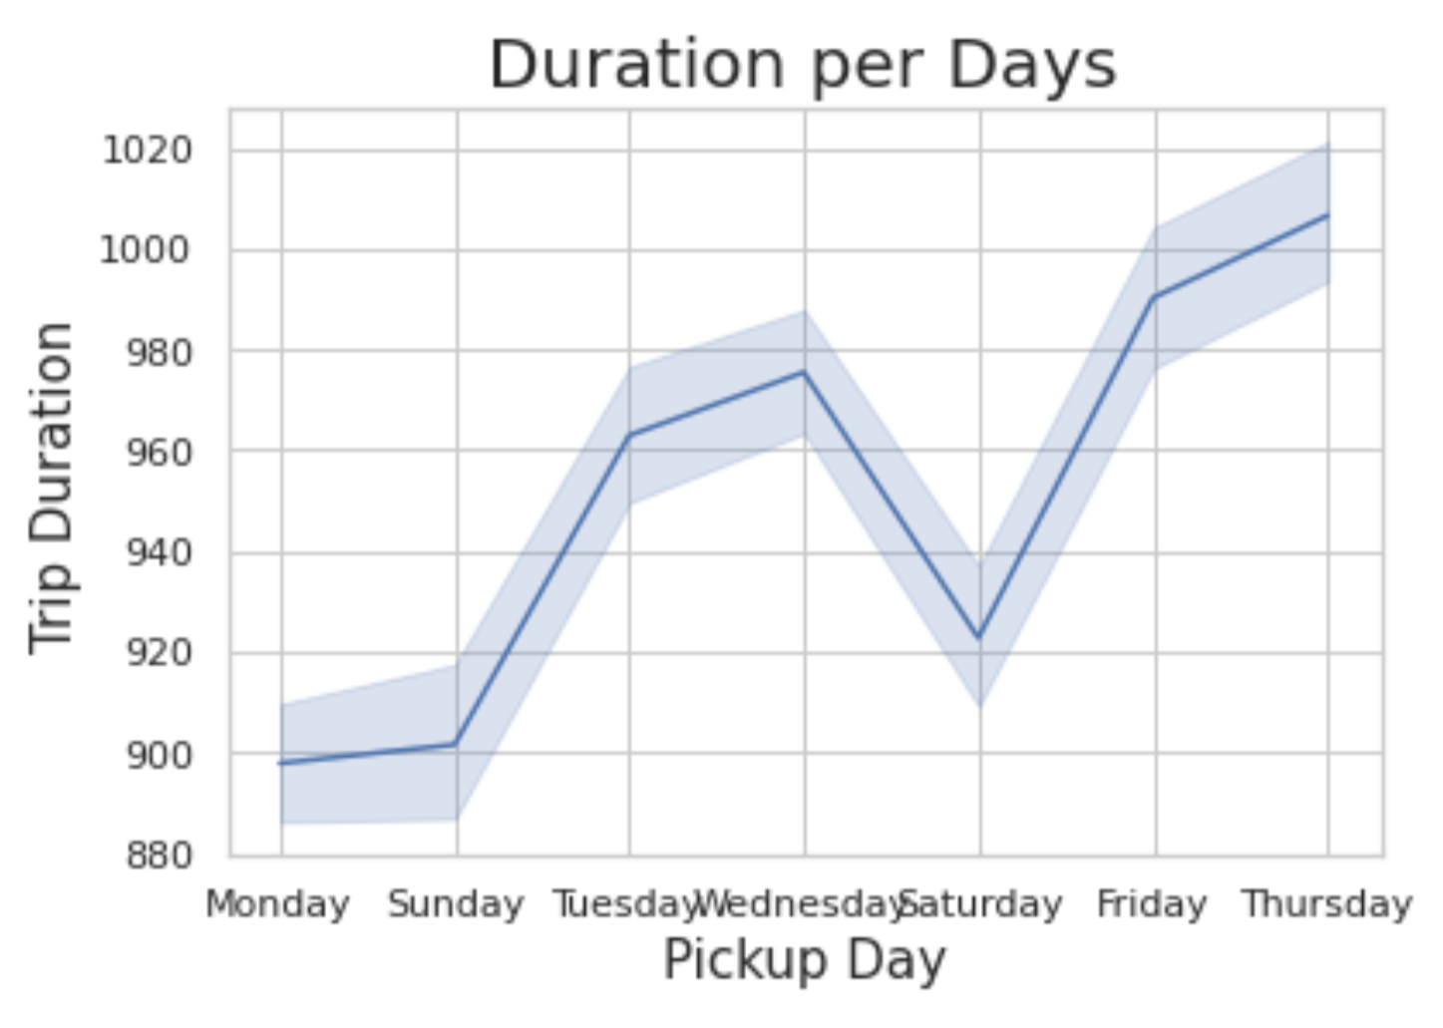
EDA :
03-1
Trip Duration per Hour and per Day

Slide 8
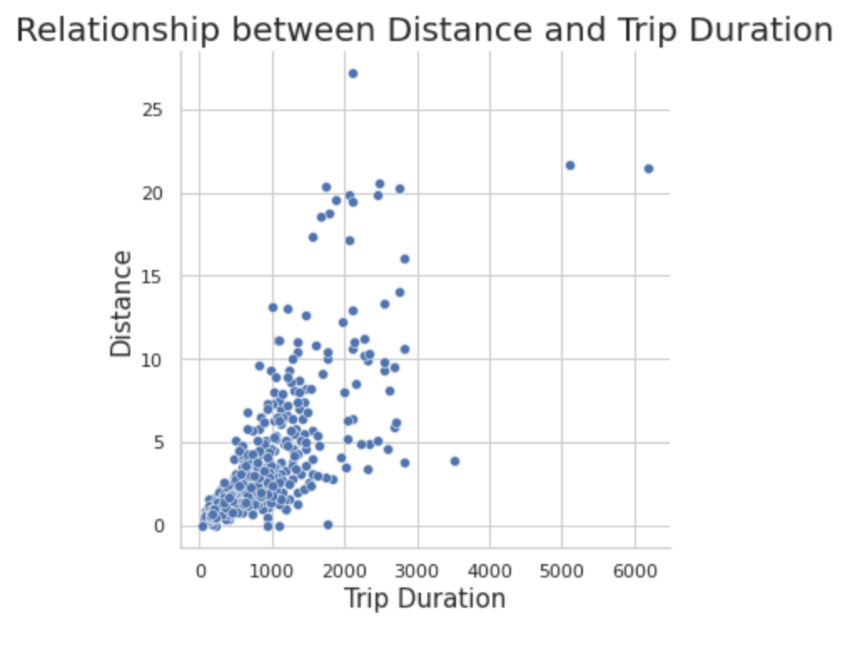
EDA :
03-2
Is there a relationship between Distance and Trip Duration?

Slide 9
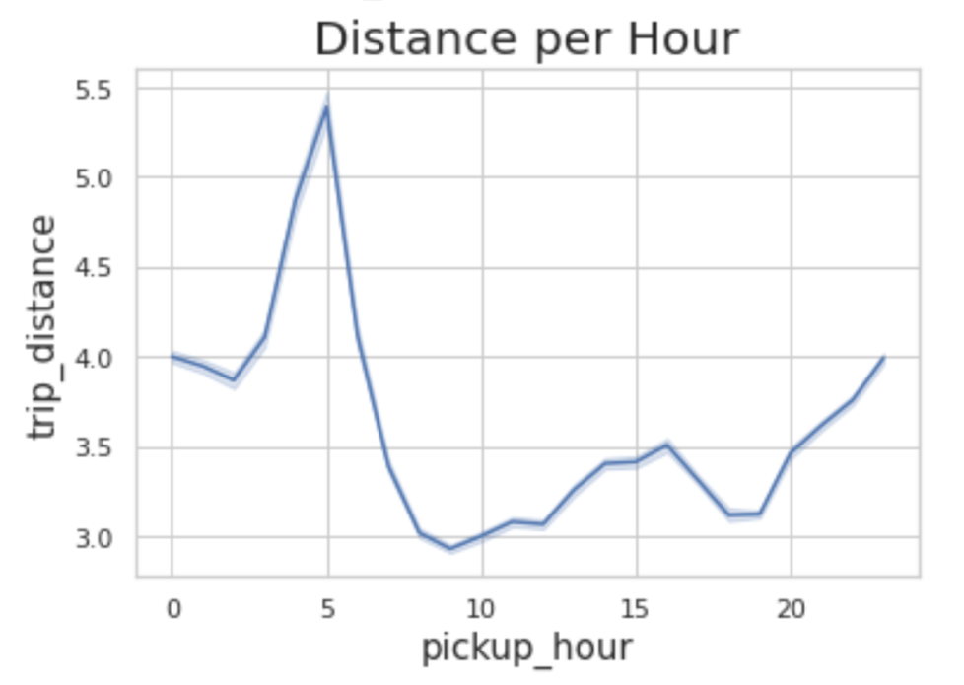
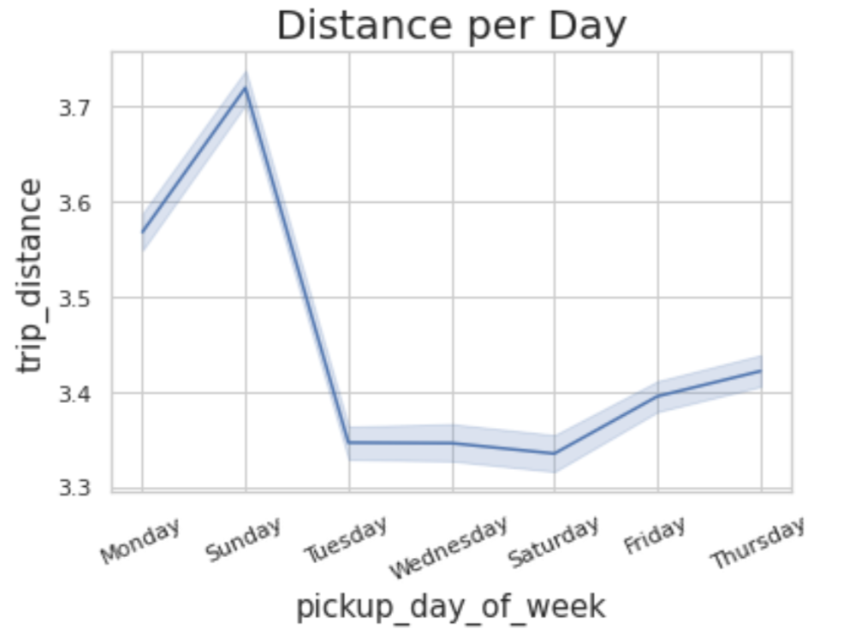
EDA :
03-3
Distance per Hour and per Days

Slide 10
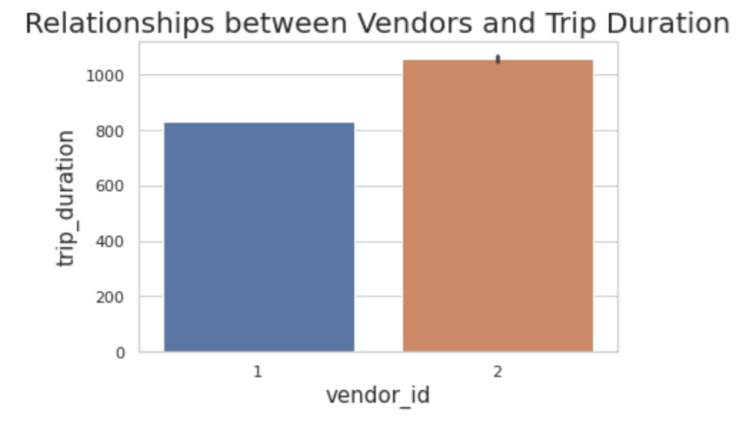
EDA :
03-4
Is Vendor Id have relationships with Trip Duration?

Slide 11
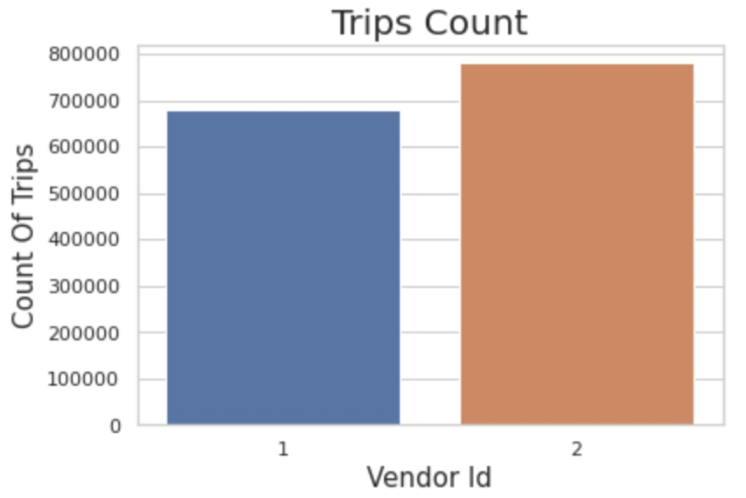
EDA :
03-5
What Vendor have the most Trips?

Slide 12
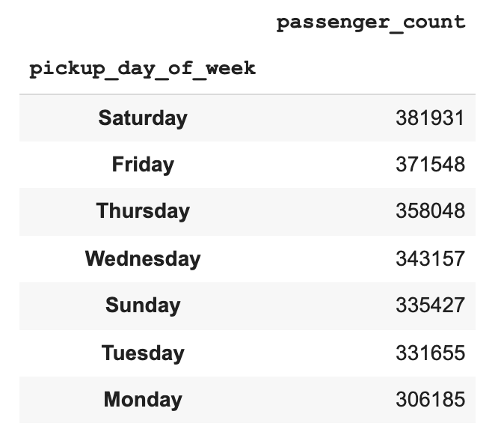
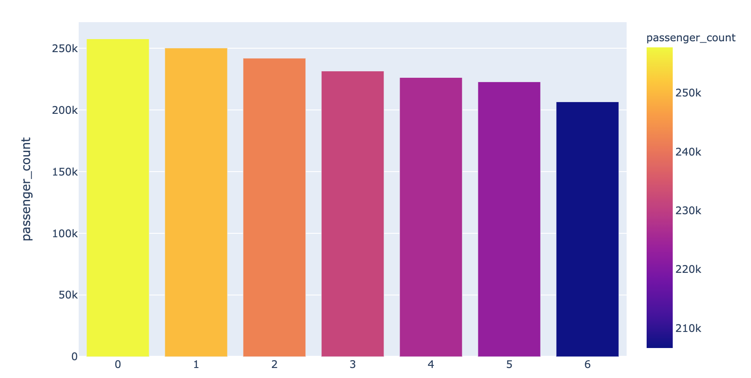
EDA :
03-6
Which Days has the highest number of Passengers?

Slide 13
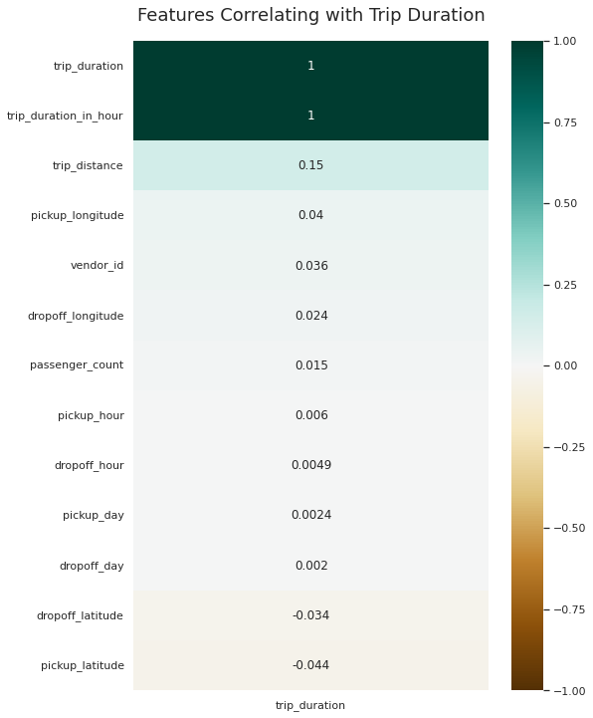
EDA :
03-7
Features Correlating with Trip Duration

Slide 14
Model :
04-1
Time Series
 | Test Mean Absolute percentage Error :
Arima | 83

Slide 15
Conclusion
To conclude this project will be revisited and we will try to fit a model to predict the trip duration for the NYC Yellow taxi company. whoever, the next step is to sign a new contract with NYC yellow taxi company under our terms and condition to choose a good model that fit the dataset.
05

Slide 16
06
Tools :
Trello
PowerPoint
02
04
03
05
01
GitHub
Python
VScode
Pandas, NumPy, Seaborn, Plotly, sklearn

Slide 17
Thank You
Shatha Alghamdi
Elham Alzahrani
Shaima Alzahrani
Ayad Alharbi

